Slide 1
PLD Design and Constraint
Part 2
Course : CPEN6265010 Digital System
Effective Period : September 2025

Slide 2
Related LO
Learning Objectives
LO3: Utilize Hardware Description Languages (HDLs).

Slide 3
Outlines
Programmable Logic Software
Functional Simulation
Synthesis
Implementation
Timing Simulation
Device Programming
Boundary Scan Logic

Slide 4
Programmable Logic Software
All manufacturers of programmable logic provide software to support their products. The process is illustrated in the flowchart.
The first step is to enter the logic design into a computer. It is done in one of two ways:
1) Schematic entry
2) Hardware description language (HDL).

Slide 5
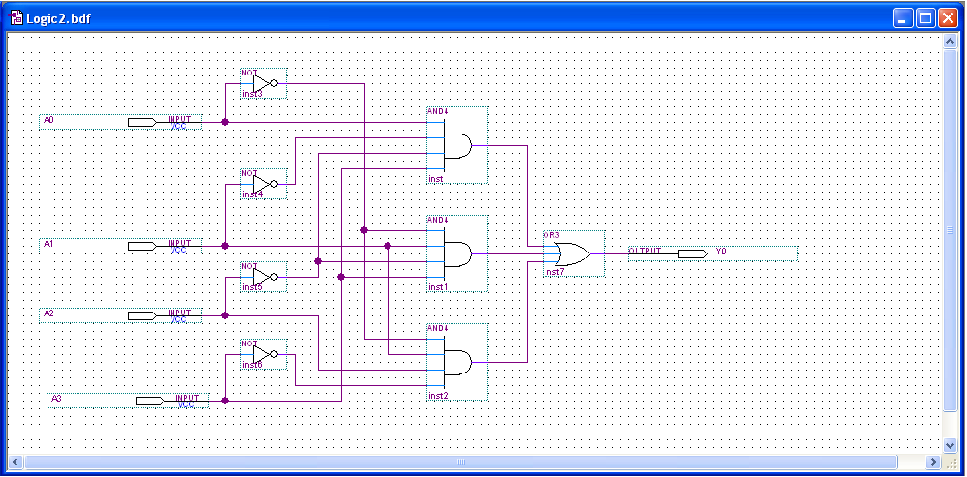
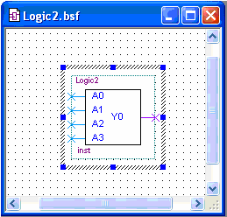
Programmable Logic Software
In schematic entry, the design is drawn on a computer screen by placing components and connecting then with simulated wires. You do not need to know the details of an HDL. After drawing the schematic, it can be reduced to a single block symbol:

Slide 6
Programmable Logic Software
In text entry, the design is entered via a hardware description language such as VHDL or Verilog.
VHDL has two key parts: the entity and the architecture. The entity section describes the inputs, outputs, and variables. The architecture section describes the relationships between variables using Boolean equations. The VHDL equation can be understood, even if you do not know VHDL.
For example, the VHDL expression for LED1 is written as
LED1 <= ((D XOR C) XOR B) XOR A;

Slide 7
Programmable Logic Software
VHDL allows you to describe components in one program and then use them in another program.
For example, an active-LOW S-R latch can be drawn as
The complete VHDL program for this component is shown on the following slide…..

Slide 8
Programmable Logic Software
entity S_RLatch is
port (A, B: in bit; Q, QNot: inout bit);
end entity S_RLatch;
architecture Behavior of S_RLatch is
begin
Q <= not A or not QNot;
QNot <= not B or not Q;
end architecture Behavior;
Entity section
Input and output variable names and types
Architecture section
}
Boolean descriptions of circuit
Assigns expression on right to variable on left

Slide 9
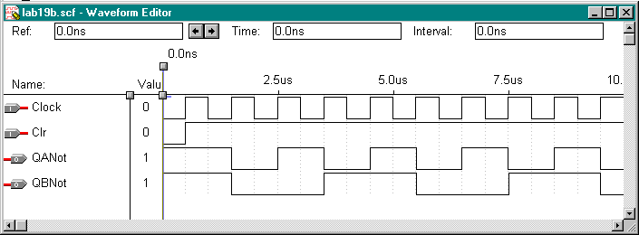
Functional Simulation
After entering the circuit into an HDL (such as VHDL), the circuit is tested in a functional simulation. The functional simulation is part of the HDL. You can test the circuit with waveforms to verify the operation.
Example
The following shows the functional test of a counter using a waveform editor:

Slide 10
Synthesis
After the simulation, the computer program optimizes the logic by eliminating redundant terms and generating a netlist, (a connection list) that is a complete description of the circuit.
Netlist

Slide 11
Implementation
The computer next “maps” the design from the netlist to fit it to a target device. Data for all potential target devices are in a software library. The computer must account for the I/O pins and fit the logic to the target device.

Slide 12
Timing Simulation
After implementation, a timing simulation is done that takes into account the specific delays in the target device and verifies that there no problems with the timing. As in the case of the functional simulation, the waveform editor can be used to review final timing.
If a problem is revealed, it is not too late to correct it before downloading the file.

Slide 13
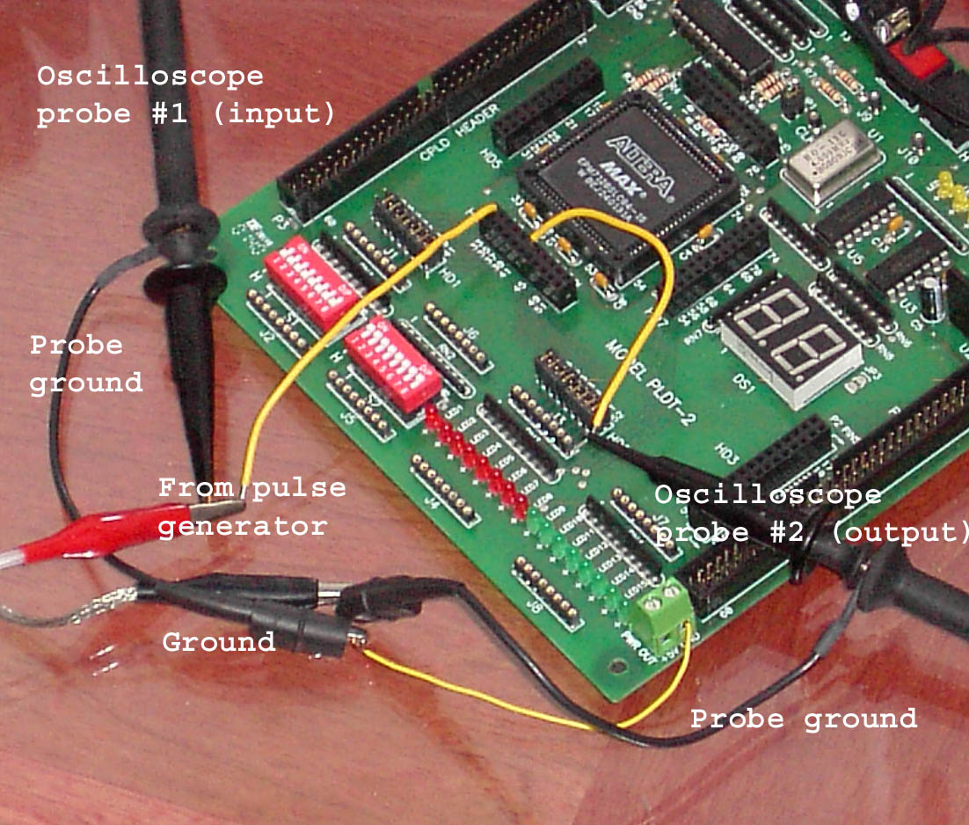
Device Programming
The final step is to send the programming file from the computer to the target device and test the implementation.
A PLDT-2 prototyping board that has an Altera PLD as the target device is shown. Connections are added to the board from a pulse generator and oscilloscope to test the actual circuit in a laboratory environment. The prototyping board has built-in power supplies, interfacing, I/O, and more.

Slide 14
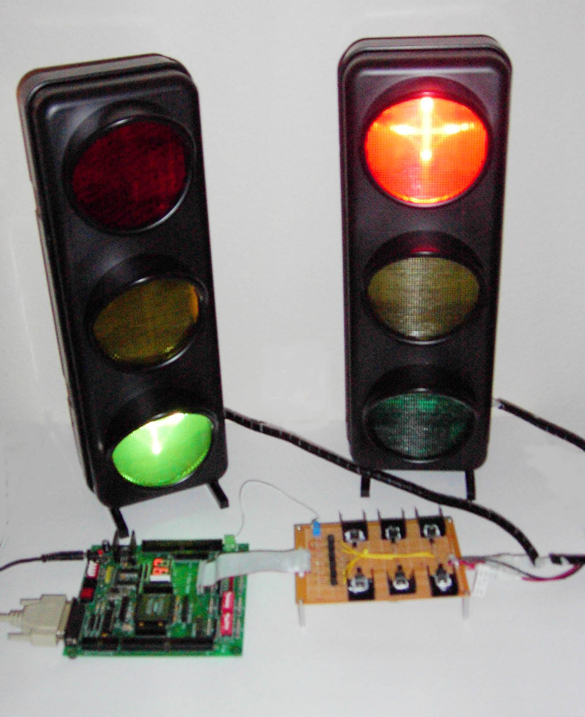
Testing
The traffic light system application was described in several System Application Activities in the text. The photograph is the traffic light logic downloaded to a PLDT-2 board and operating a simulated traffic light. An interface is added to allow for the voltage and current requirements of the bulbs.
PLDT-2 board
Interface board

Slide 15
Boundary Scan Logic
Boundary scan that is designed by the manufacturer of programmable devices to provide a means of testing and programming the device without requiring physical access to the internal logic. Programmable devices that are compliant with a certain standard have internal registers to allow testing of internal interconnections and logic. Test data is supplied and verified. When the circuit is operating, the boundary scan logic is “invisible”.
The following slide shows a boundary scan logic diagram…

Slide 16
Boundary Scan Logic

Slide 17

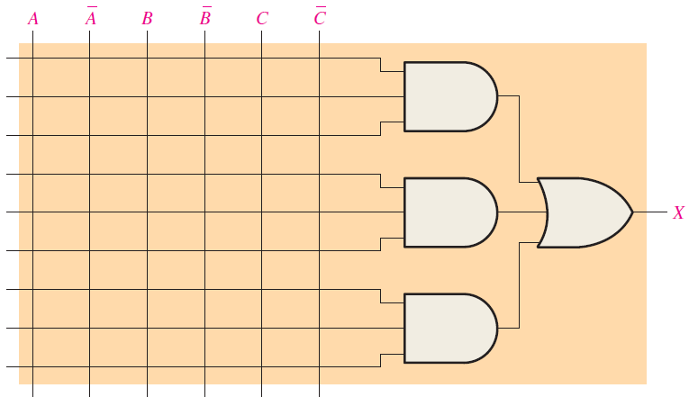
Exercise
Show how the PAL-type array in next Figure should be programmed to implement each of the following SOP expressions. Use an X to indicate a connected link.

Slide 18
References
Null, Linda (2024). "The essentials of computer organization and architecture". 6th edition. Jones & Bartlett Learning, Burlington, Massachusetts. ISBN: 9781284259438..
Thomas L. Floyd. (2014). “Digital Fundamentals”. 11th Edition. Prentice Hall. New Jersey. ISBN: 978-0132737968.
VHDL Tutorial: http://esd.cs.ucr.edu/labs/tutorial/
Introduction to VHDL : https://www.nandland.com/vhdl/tutorials/tutorial-introduction-to-vhdl-for-beginners.html

